Slide 1
UBER/OLA TAXI SIMULATOR
PRATYAY DUTTA – 001910701095

Slide 2
Abstract
When it comes to cab rental services, Taxi Service is the most trusted and reliable name in the travel business. The most advanced travel agents offering cab rental and car hire in India, making full use of information technology to improve the level of our efficiency. However, this is only one aspect of services. And this project continually strives to offer the best of services - both in terms of man and machine, to our clients Moreover, this project has a fleet of cars ranging from luxury to budget cabs. While, it offers online cab hire service for corporate houses. And this project claims to offer the best of rates, which are tailor-made depending upon the facilities, availed and offer both intercity and intra-city cab facilities.

Slide 3
Introduction
As a small scale implementation of the most basic taxi booking system, we have constructed a python simulator which simulates the environment of the quintessential urban city life in Kolkata.
The project mainly focuses on how a booking and payment system works in almost all taxi applications. It takes into account:
The allotment of taxis.
The time required for that taxi to reach the person booking the ride.
The time required for the person to reach their destination from the time of its starting.
The bill payable at the end of the ride.

Slide 4
Overview
Our implementation makes heavy use of the Google cloud and Google maps APIs that google have made accessible to all thereby creating a vast database that can be accessed by all to create all kinds of innovations. The Google APIs are used by the booking apps themselves and that just goes to show how robust and trustworthy their resources are.
Our implementation also includes a Machine learning algorithm called Kmeans clustering which is very widely used for clustering techniques. We have used it to cluster locations on the basis of which our taxi allotments take place. It has been dealt with much more closely in a later section of this presentation.

Slide 5
RELATED WORKS
INSIGHTS ON THE METHODS

Slide 6


1. GOOGLE APIS
Google APIs are application programming interfaces (APIs) developed by Google which allow communication with Google Services and their integration to other services. Examples of these include Search, Gmail, Translate or Google Maps. Third-party apps can use these APIs to take advantage of or extend the functionality of the existing services.
The APIs provide functionality like analytics, machine learning as a service (the Prediction API) or access to user data (when permission to read the data is given). Another important example is an embedded Google map on a website, which can be achieved using the Static maps API, Places API or Google Earth API.
Google Apps Script is a cloud-based JavaScript platform which allows developers to write scripts only owner can manipulate API services such as Calendar, Docs, Drive, Gmail, and Sheets and easily create Add-Ons for these services with chromium based applications.

Slide 7
Use cases of Google APIs
User registration is commonly done via Google, which allows users to securely log into third-party services with their Google account through the Google Sign-in system. It is popular to include a "Sign in with Google" button in Android apps, as typing login credentials manually is time-consuming due to the limited screen size
Drive apps are various web applications which work within Google Drive using the Drive API. Users can integrate these apps into their Drive from the Chrome Web Store, allowing them to work entirely in the cloud.
App Engine are web apps that run on the Google App Engine, a platform-as-a-service (PaaS) cloud computing platform which allows web developers to run their websites in Google datacenters.

Slide 8
2. KMEANS CLUSTERING
K-means clustering is a method of vector quantization, originally from signal processing, that aims to partition n observations into k clusters in which each observation belongs to the cluster with the nearest mean (cluster centers or cluster centroid), serving as a prototype of the cluster.
The unsupervised k-means algorithm has a loose relationship to the k-nearest neighbor classifier, a popular supervised machine learning technique for classification that is often confused with k-means due to the name. Applying the 1-nearest neighbor classifier to the cluster centers obtained by k-means classifies new data into the existing clusters. This is known as nearest centroid classifier or Rocchio algorithm.

Slide 9
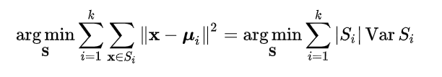
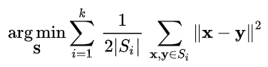
Mathematics behind it
Given a set of observations (x₁, x₂, ..., x_{n}), where each observation is a d-dimensional real vector, k-means clustering aims to partition the n observations into k (≤ n) sets S = {S₁, S₂, ..., S_{k}} so as to minimize the within-cluster sum of squares (WCSS) (i.e. variance). Formally, the objective is to find:
where μ_{i} is the mean of points in S_{i}. This is equivalent to minimizing the pairwise squared deviations of points in the same cluster:

Slide 10
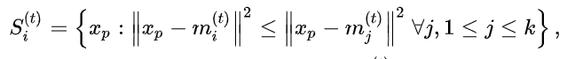
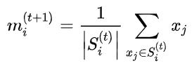
Algorithm( Naive K-Means )
The most common algorithm uses an iterative refinement technique. Due to its ubiquity, it is often called "the k-means algorithm"; it is also referred to as Lloyd's algorithm, particularly in the computer science community. It is sometimes also referred to as "naïve k-means", because there exist much faster alternatives.^{[6]}
Given an initial set of k means m₁⁽¹⁾,...,m_{k}⁽¹⁾ (see below), the algorithm proceeds by alternating between two steps:
Assignment step: Assign each observation to the cluster with the nearest mean: that with the least squared Euclidean distance.^{[8]} (Mathematically, this means partitioning the observations according to the Voronoi diagram generated by the means)
Update step: Recalculate means (centroids) for observations assigned to each cluster.
Convergence of kmeans

Slide 11
ISSUES
THOSE NEED TO BE ADDRESSED

Slide 12
Computational Problems
The old manual system was suffering from a series of drawbacks. Since whole of the system was to be maintained with hands the process of keeping, maintaining and retrieving the information was very tedious and lengthy.
The records were never used to be in a systematic order. there used to be lots of difficulties in associating any particular transaction with a particular context.
If any information was to be found it was required to go through the different registers, documents there would never exist anything like report generation.
There would always be unnecessary consumption of time while entering records and retrieving records. One more problem was that it was very difficult to find errors while entering the records. Once the records were entered it was very difficult to update these records.

Slide 13
Practical problems
Booking a cab in a metropolitan city was a hassle from the very beginning.
In most cases, cab drivers had all the liberty to choose and refuse to go to places where it was not entirely feasible for them. Yellow taxis were in abundance and yet people had to wait for hours on end to get a booking to reach their destination.
The billing meter was absolutely haywire. The meter on most taxis were broken, or faulty or even tampered to show higher rates then usual. In most cases, the drivers never adhered to the meter in the first place and asked for exorbitant prices from unsuspecting customers who had no choice but to give in.

Slide 14
Problem of plenty
An important percentage of the cars (e. g. 60% in Hong Kong (Yang et al. 2000)) in the daily flow are taxis, most of them empty taxies. This situation is creating two problems:
An internal problem to the taxi drivers (higher empty kilometers means lower benefits).
An external problem to the citizens (congestion and pollution). The first problem is being aggravated with the actual economic crisis, which is breaking the market equilibrium: demand is decreasing due to the lower incomes of the population and offer is increasing due to the increasing number of taxi drivers
Market equilibrium cannot be achieved in this concrete market because of the regulations, and cannot go to the next equilibrium point due to the price policies imposed in each city. This is a vicious cycle, where empty hours are increasing, and taxi drivers need to work more time in order to have the same income, which means lower income per hour (Daniel (2006)).
In this situation, taxi drivers prefer to stop at taxi stands and wait for a client, without expending fuel in empty trips and consequently saturating the taxi stands. If taxi stops network is not well designed, this situation will create a decrease in the Level of Service of the passengers, decreasing the demand and congesting the streets near the taxi stops.

Slide 15
LITERATURE SURVEY
DISCUSSIONS

Slide 16
Actual cities are oversaturated, on one hand most of the population is concentrated in large cities (in 2030 more than 80% (UNFPA 2007) of the population will live in urban areas), on the other hand mobility needs of the modern population are growing continuously. While urban demand for trips is growing constantly, supply (capacity of city streets) is limited, and must be optimized, not increased (most of the times not possible inside the city). Well-planned, efficiently operated, and cost-effective transportation system management (TSM) strategies can improve mobility of existing systems for transportation users, especially in urban environments, where a good optimization of the infrastructure is needed (considering the high cost of building new facilities and the continuously increasing demand resulting from economical and population growth). Last years tendencies are shifting person trips from private vehicles to public vehicles, increasing the Public Transport share importantly. The most used Public Transports are the “Mass Transports” such as metro, tram or bus. This kind of transport usually has a centralized management which uses ITS technologies developed in the last decade for an optimal operation of the service.
Unfortunately, inflexibility, long total travel time and insufficient service coverage of Mass Transport systems cause a lower usage of them in most metropolitan areas. Oppositely, the taxi-cab sector is a more convenient mode due to its speediness, door-to-door attribute, privacy, comfort, long-time operation and lack of parking fees.

Slide 17
IDEAS
AND THE PROCESSES

Slide 18
Workflow - 1
The main idea behind this work is to construct a robust booking and billing system that can be used in all use cases with additional tweaks and simulations. We seek to ask the user to input their location and according to the location entered, we will be allotting them the active cab which is closest to him. The location’s geographic coordinates will be retrieved from the Goole Maps API and its geographical location from a taxi whose location will be previously allotted can be computed using the Distance Matrix API of Gmaps. We will also be showing the estimated time required for the taxi to reach the pickup spot. This time can also be retrieved from the API which takes into account, the weather and traffic conditions and predicts the estimated time using a very robust and foolproof AI algorithm. I will be including the documentation of the geocoding function of the Gmap API which can be visited for greater in depth understanding.
Google Maps API documentation. This link contains the documentation.

Slide 19
Workflow – 1.a
In the backend of the allocation algorithm, we will be creating a dataset of around 200 locations in Kolkata whose coordinates we will be getting from the Google API. After we track down their position coordinates, we will be feeding it to a clustering algorithm (Kmeans clustering), which is an unsupervised machine learning algorithm that clusters points together on the basis of their locations in a vector space.
The locations of Kolkata will be clustered into various areas. Now when we get the location of the user from their input, two things happen:
The string variable goes straight to Google and we receive the position coordinates of that location.
The location is then fed into the clustering algorithm which was previously trained with the >200 locations and it predicts the cluster, the inputted place would fall into.

Slide 20
Workflow-1.b
Now according to the cluster which the location falls in, the simulator scans the taxis present in that location and finds the taxi with the minimum distance from the location and allots it.
After allotment, the location of the taxi and the user are fed in Google Maps again and the estimated time remaining for the taxi to reach the user is retrieved.
The taxis have been initialised before with randomly allocated locations and car numbers. Since the locations were previously clustered, hence the cluster in which the taxi’s location falls is also stored in the information of the taxi.

Slide 21
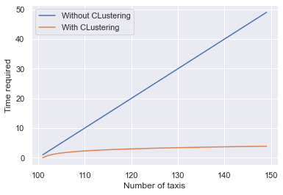
Workflow 1.c
A major advantage of clustering and allocating is a great increase in efficiency of the booking system because if everytime we had to scan the entire city to book a single taxi, it would be very computationally expensive.
A visual illustration of how time required to allot taxis varies with increase in number of taxis with and without clustering.

Slide 22
Workflow - 2
The second part of our work focuses on the the billing of the ride.
The billing depends on three factors:
The time of day
The distance between pickup and destination
The time taken to traverse that distance
The rates vary from morning to night. So we first determine the time of the day in which our user books his taxi. Accordingly the fare will be determined. It is higher at night and lower during the day. This is to provide security for the drivers who work at night and do not acquire much passengers.
The Google maps distance matrix api returns the distance between our pickup and location and based on the distance, we can calculate the bill.
The taxis will charge an additional nominal fare for each minute spent during transit.

Slide 23
Workflow 2.a
The time of the day can be determined by noting the time when the user s inputting the location.
The geographical distance can be found out by the google api.
The time taken in transit can be found out using a parameter of rhe distance matrix api which takes into account traffic conditions and road blockages while predicting a time based on a very foolproof AI algorithm.

Slide 24
RUNDOWN-1
CLUSTERING

Slide 25
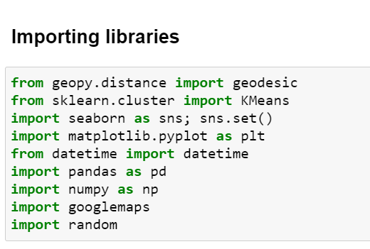
Importing our libraries
These are the libraries required to implement our simulator. The pandas is a special python library that helps us to control and work with data frames. The numpy library allows us flexibility in calculation. The random module is used to generate random numbers.

Slide 26
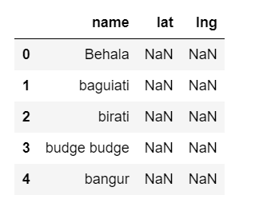
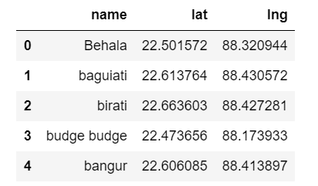
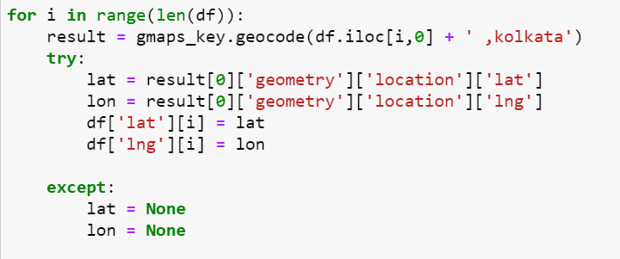
Dataset for clustering
Our original dataset, contained names of 200+ places inside Kolkata. After passing it through the code where the geocode function returned the latitudes and longitudes of the location names, we saved the latitudes and longitudes in our dataframe.

Slide 27
Clustering
K-means is somewhat naive — it clusters the data into k clusters, even if k is not the right number of clusters to use. When we come to clustering, it’s hard to know how many clusters are optimal. Therefore, when using k-means clustering, we need a way to determine whether we are using the right number of clusters.
One method to validate the number of clusters is the elbow method. The idea of the elbow method is to run k-means clustering on the dataset for a range of values of k (say, k from 1 to 10), and for each value of k calculate the Sum of Squared Errors (SSE).
When K increases, the centroids are closer to the clusters centroids. The improvements will decline rapidly at some point, creating the elbow shape. That is the optimal value for K.

Slide 28
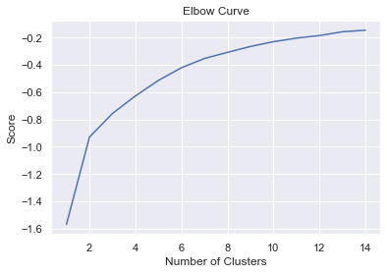
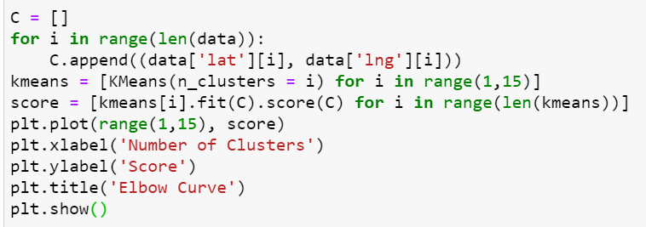
Determining number of clusters
To determine the number of clusters, we run kmeans on our data for number of clusters in the range of 1 to 15. Then we plot the SSE for each iteration. The point at which there is an ‘elbow’, we pick that as the number of clusters.
It is clear from the plot that the elbow occurs at number of clusters = 2. So we pick 2 as the number of our clusters.
CODE

Slide 29
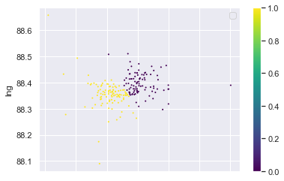
Visualising our clustered locations
We have decided on our cluster numbers and it is 2. Now we go on and feed our dataset into the clustering algorithm such that the algorithm clusters all the locations present in our dataset into two clusters. Results of the clustering were interesting as we could clearly distinguish between our locations in clustered data. For example places like ‘Bangur’, and ‘College street’ fell in cluster 0 and places like ‘Kalighat’, ‘Ballygaunge’ fell in cluster 1, which makes us infer that cluster 0 has places of north Kolkata and cluster 1 has the places of south Kolkata. The plot of the locations (x = latitude, y = longitude) will make it more clear. Yellow = cluster 1, Purple = cluster 0.

Slide 30
RUNDOWN-2
BOOKING A TAXI

Slide 31
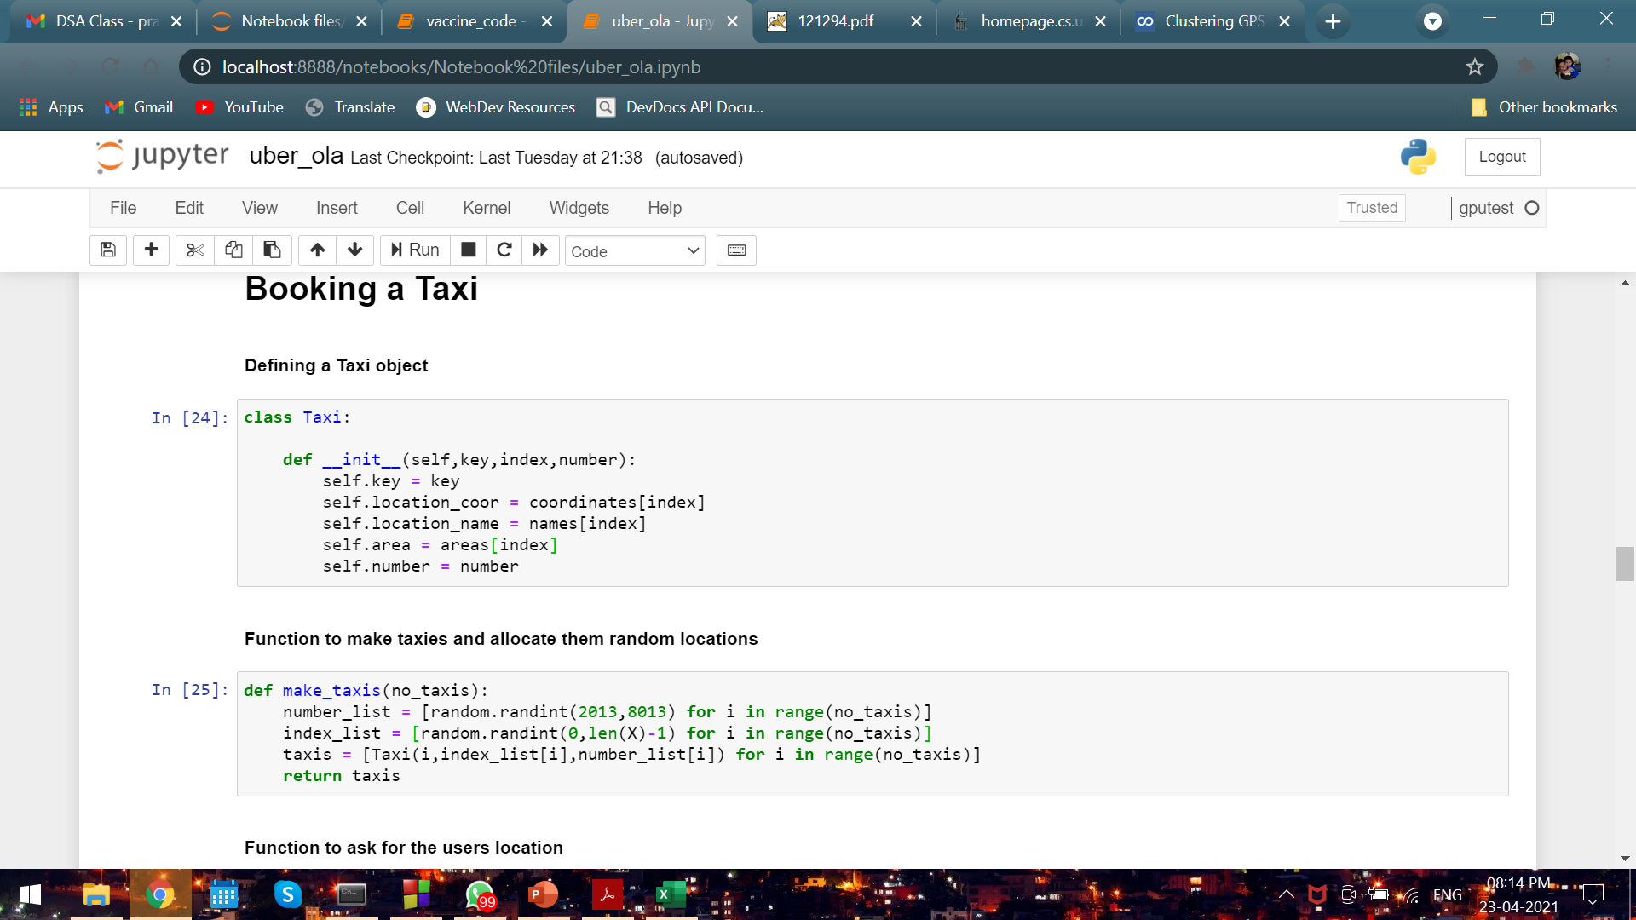
Defining a taxi
We use Object Oriented Programming(OOP) to create a taxi class that contains the following information about the taxi:
The taxi number: A unique 4 digit number.
The location of the taxi. Eg- Phoolbagan, Rajarhat, etc
The geographical coordinates of the location.
The area in which the taxi falls i.e the cluster label.
The key of the taxi refers to its index which is used in keeping count of the taxis.

Slide 32
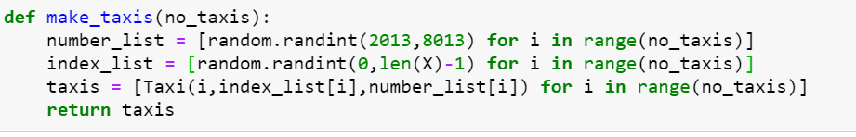
Make the taxis
We create a function make_taxis(n) which takes in an integer parameter n and creates n taxi objects.
It creates a number list which contains ‘n’ random 4-digit numbers which will be used to allocate the taxi number.
It creates an index list of ‘n’ elements which has random integers in the range (0,len-1) where len is the size of our dataset. This list is required to allocate random locations to the taxis based on the index.
It returns a list of taxi objects.

Slide 33
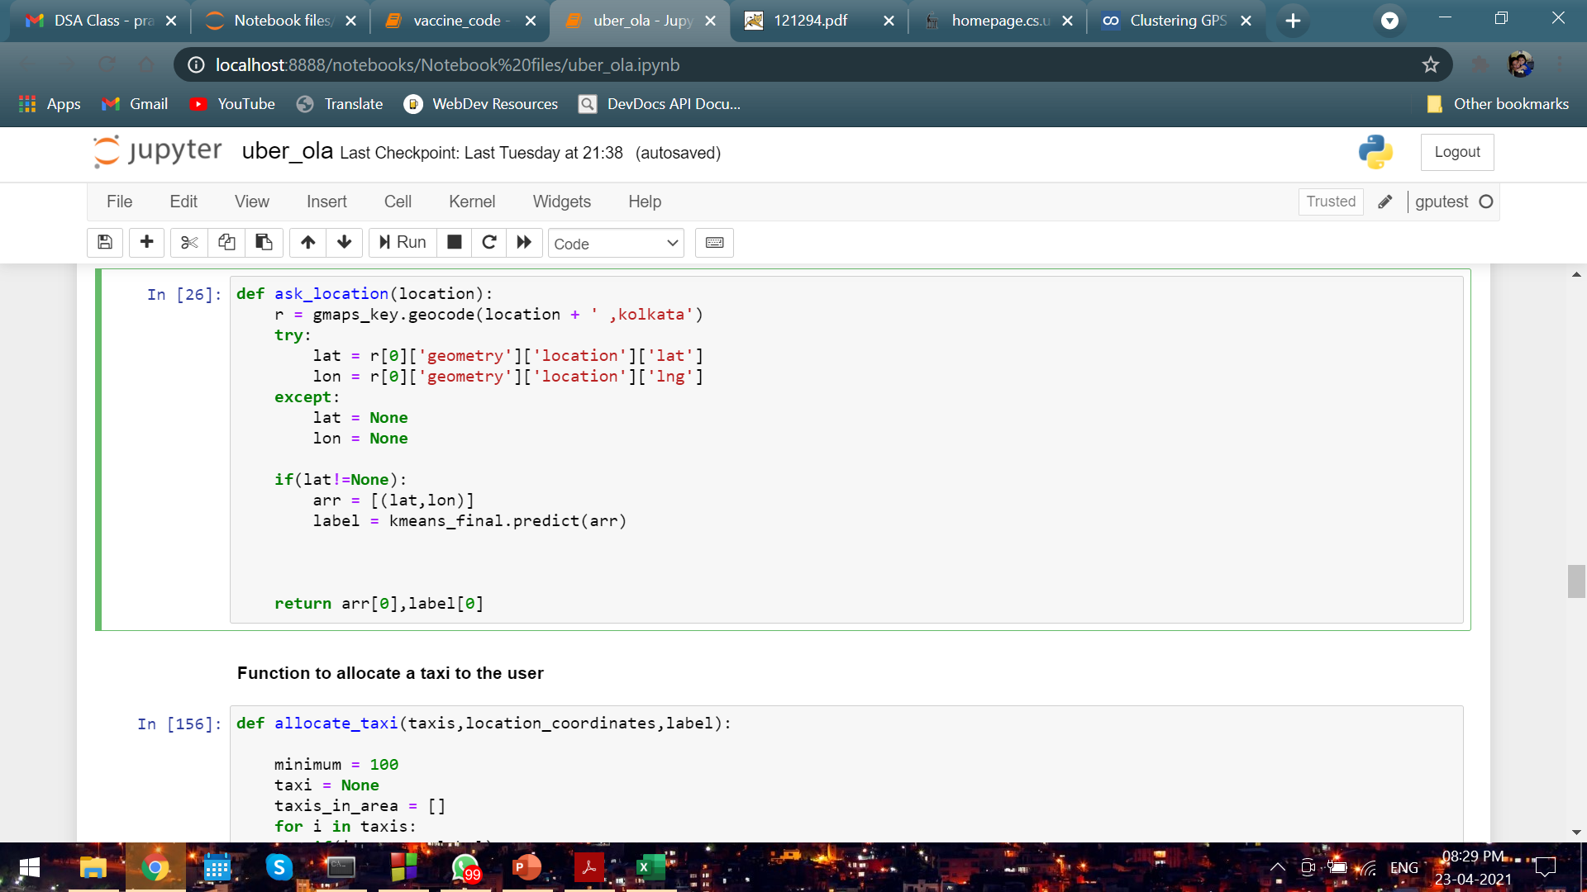
Asking for the users location
We make a function “ask_location()” which has a parameter location. So once the user inputs the location string, it is sent as an argument to this function which takes the string, sends it to Google Maps, retrieves the latitude and longitude of the location and stores them in variables ‘lat’ and ‘lon’ respectively.
The lat and lon are stored as a tuple in ‘arr’ and the label variable stores the predicted cluster number of the location.
The function returns the tuple containing the coordinates and the cluster label of the location.

Slide 34
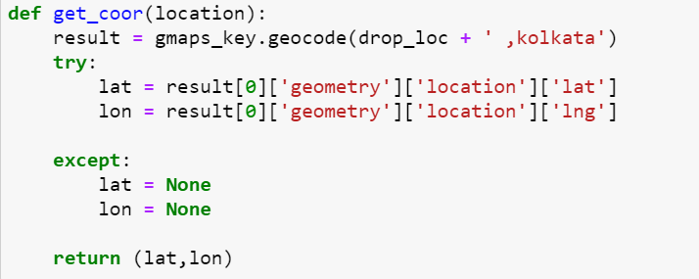
Getting the coordinates of a location
The function get_coor() takes in the name of the inputted location as an argument and returns the latitudes and longitues of that location as received from the Google Map API as a tuple.

Slide 35
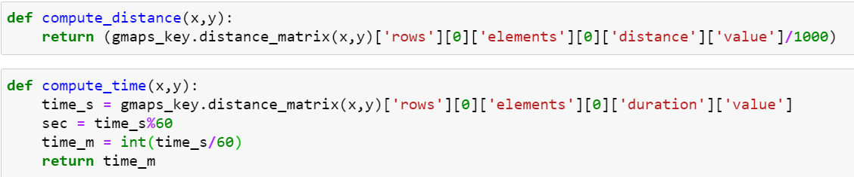
Computing distance and time
We make two functions which compute the distance between two locations and which computes the estimated time required to move from one location to another based on traffic conditions.
The compute_distance() function takes two arguments x and y which are the locations between which we want to compute the distance. It returns the geographical distance between those two locations in kilometers.
The compute_time() function also takes the similar two arguments x and y of two locations. The ‘duration’ key in the distance matrix api returns time taken in seconds which we convert to minutes before returning the time in minutes.

Slide 36
Allocating a taxi - 1
This is perhaps the heart of our simulation code wherein on the basis of the location inputted by the user, we allocate a taxi to the user.
The parameters of this allocate_taxi() function includes:
The list ‘taxis’ which will be returned once we call the make_taxis() function.
The location coordinates of the user’s inputted location.
The cluster label of the user’s inputted location.
It creates a new list which stores the taxis, the location of which fall in the same cluster as the location of the user input.
This is used to reduce the sample space for the searching the minimum distance.

Slide 37
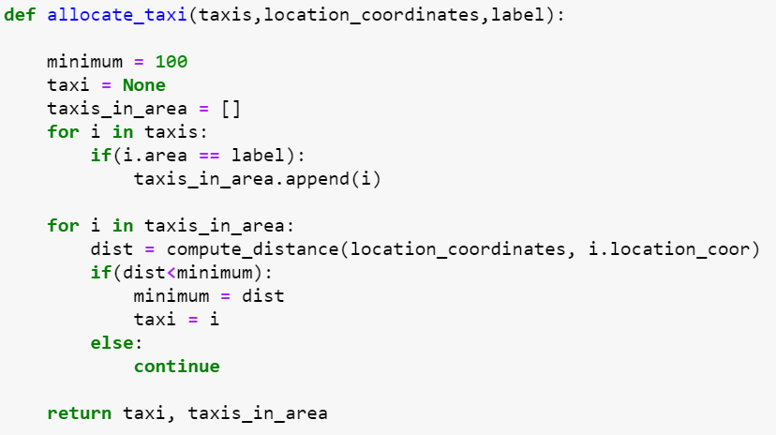
Allocating a taxi - 2
After it creates the new list ‘taxis_in_area’, it parses through the list and calculates the distance of each of the taxi from the user inputted location.
The function returns :
One taxi object whose distance from the inputted location is minimum.
The list of taxis falling inside area. This will be used as cache and for later visualisations.

Slide 38
RUNDOWN-3
CALCULATING THE FARE

Slide 39
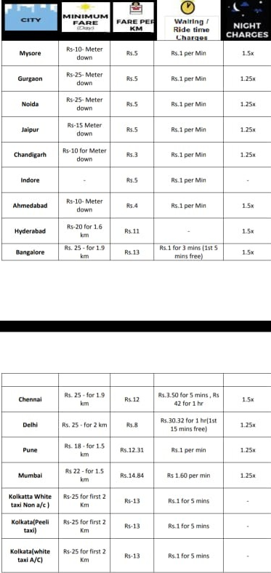
Rate calculation
Below provided is a picture taken from Uber’s website as to how they calculate fares for their trips. From this image it is clear that 3 factors have to be taken into account while calculating the fare:
The time of day
The distance between pickup and destination
The time taken to traverse that distance
For Kolkata:
Day: Rs.25 for first 2 km and then Rs.13 per extra km plus Rs.1 per 5 minute of transit time
Night: Rs.25 for first 2 km and then Rs.19.5 per extra km plus Rs.1 per 5 minute of transit time

Slide 40
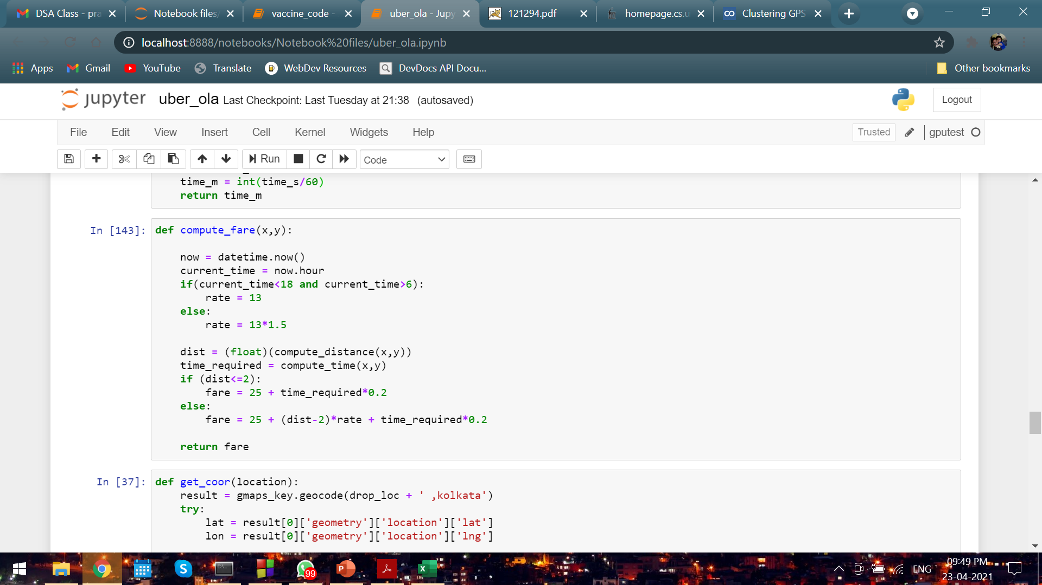
Calculation of bill
The function compute_fare() takes in the arguments x and y which are the locations of pickup and destination.
We first get the time at which the user is booking. If it is after 6pm, it is considered night.
According to the time of the day, we calculate the transit time first and then the fare according to the rates previously discussed.
The function returns a float value fare which is the bill for the ride.

Slide 41
RUNDOWN-4
DRIVER CODE/SIMULATION

Slide 42
The simulation
We first ask the user to input their pickup location and their destination.
We then call the ask_location() function to get the coordinates and cluster label of the pickup location.
We define a variable no_taxis and give it the value of the number of taxis we want deployed all over the city. We call the make_taxis() function to make the desired number of taxis with randomly allocated numbers and locations.
We call the allocate_taxis() function to get the taxi which is closest to the pickup location in its cluster.
We then calculate the distance between the pickup and drop location by the compute_dist() function
We calculate the time of transit by calling the compute_time() function and passing in the pickup and destination as arguments.
We calculate the fare for the trip.
We then display the results that we obtain from the simulation i.e:
The taxi number, time and place from where the taxi is coming to pick up the customer
The distance to be travelled
The bill.
The time required for the transit.

Slide 43
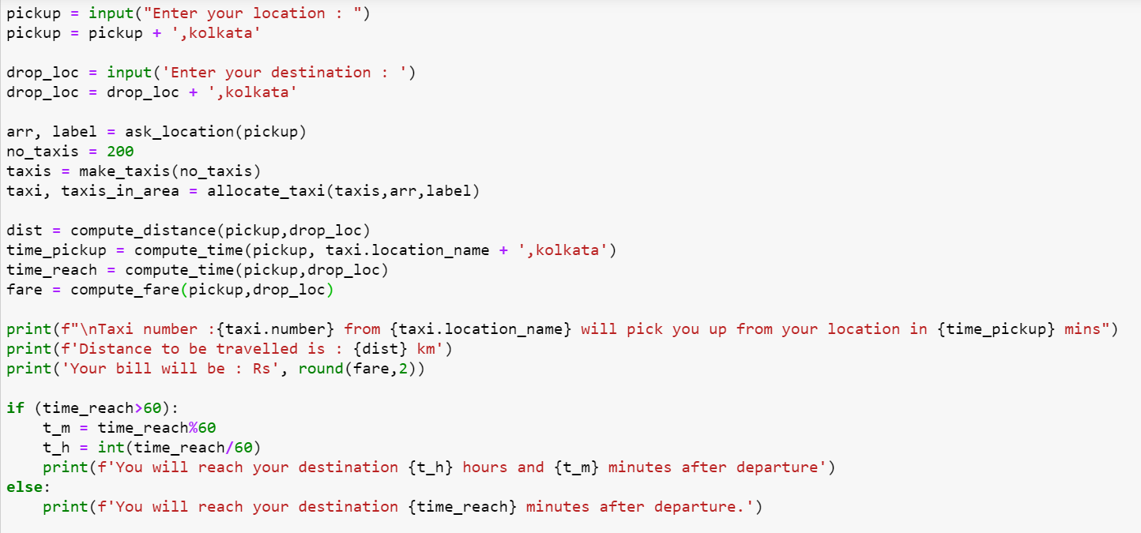
Simulation Code

Slide 44
RESULTS
SOME TEST RESULTS OF OUR SIMULATION

Slide 45
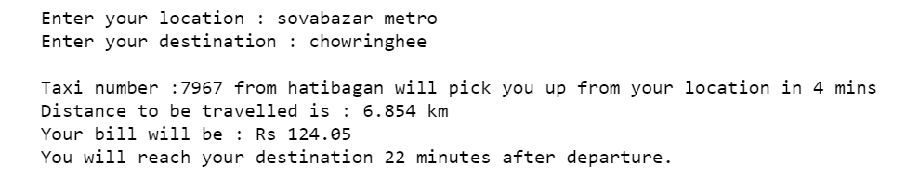
Result -1
Pickup location - sovabazar metro
Drop location - chowringhee

Slide 46
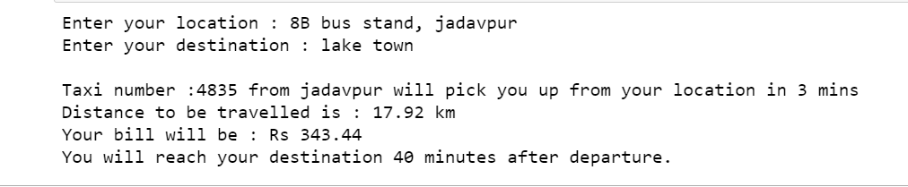
Result -2
Pickup location – 8B bus stand, jadavpur
Drop location - lake town

Slide 47
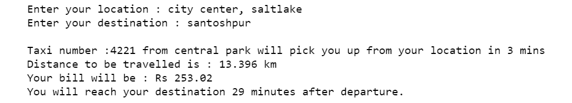
Result -3
Pickup location – city center, saltlake
Drop location - santoshpur

Slide 48
EPILOGUE
LOOKING BACK

Slide 49
Advantages of our system
Now one can easily plan the journey comfortably as the process is efficient and fast with being easy to access. Bookings can be made through the cab booking site or by phone call. This being a big step in terms of improvement in the cab system it is widely accepted across the country.
A route-based booking system that facilitates the issue of journey/booking cab, which can be issued from any station to any station. Passenger journey to multiple laps of booking can be handled from a single terminal window. The booking facility is offered round-the-clock (24 hours uninterrupted).
Changes in cab profiles (cab addition, replacement, de-allocation), route structures, etc., can be made effective immediately with the appropriate contingency handling Dynamic definition of the advance booking period is possible. This feature facilitates defining different advance booking periods for different cabs. Any cab running schedule can be accommodated. Provides on-line aggregation of EIS figures such as revenue, cab utilization, etc., and presentation of the summarized data in the form of visual analytics from the operational system's information store. The data aggregation is done incrementally, to inflict minimal impact. Provides automatic database recovery against all kinds of hardware and software failures.

Slide 50
Conclusion
Information Technology plays a vital role not only in a particular field, it provides various kinds of solutions and services to the various problems prevailing in many fields. Cabs exploits information technology at the maximum extent. It uses the information technology in an efficient way for providing better passenger services. The online booking system helps to solve the everyday problems of the average Indian.

Slide 51
THANK YOU

